Slide 1
UR+ Development Forum

Slide 2
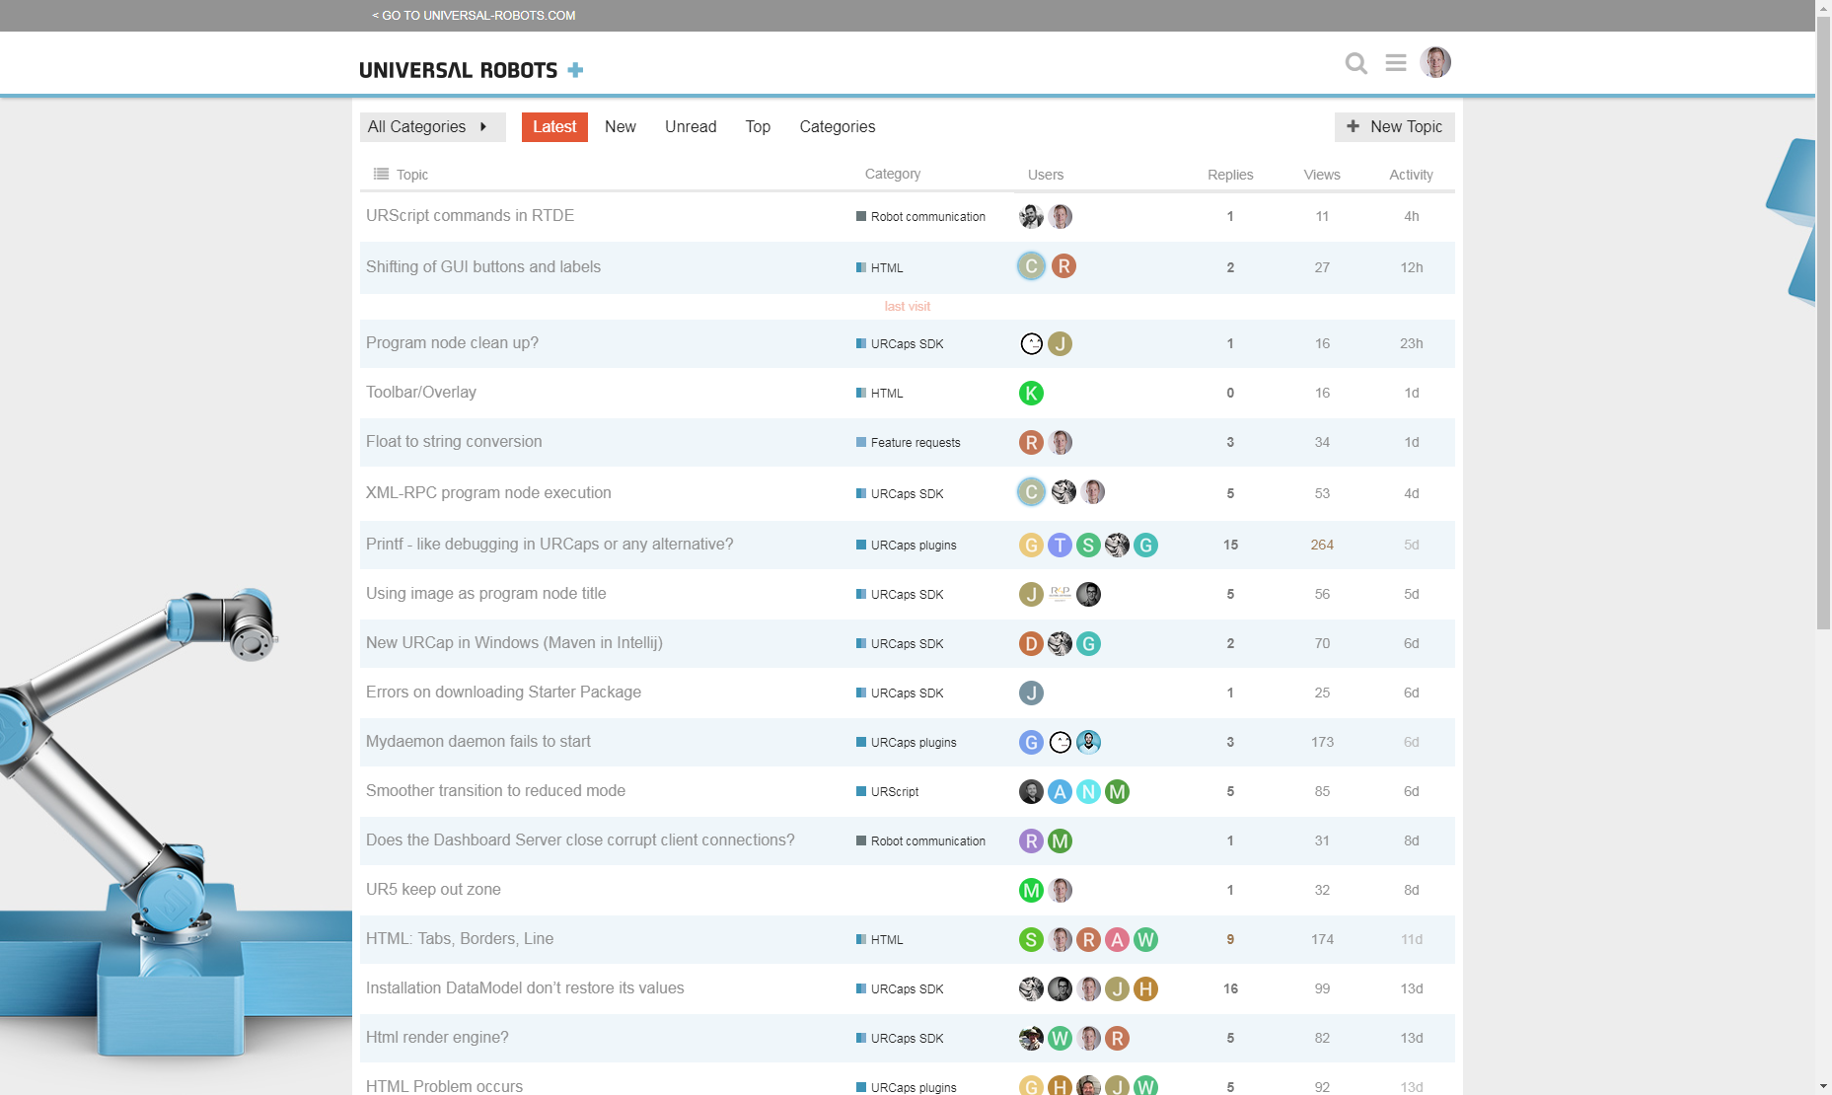
Information about UR+ in general Product guidelines, procedures, marketing information
URCaps SDK Java API, samples, starter package VM
Code level support
Links to relevant support site topics

Slide 3
Important topics
Welcome to Universal Robots+
Download URCaps SDK
URCaps Starter Package
URCaps plugins samples
External force-torque sensor implementation
Communication interfaces
Electrical interfaces
Mechanical interfaces
Good practice: …

Slide 4
Development bootcamp!

Slide 5
Agenda for today
Todays task and objective
Introduction to the URCaps SDK
Develop a URCap
Sum up

Slide 6
Todays task
Develop a URCap which functionality you define yourself. E.g. a new sample for the Development Forum, or a tool to help your daily work.
Todays objective
Gain hands-on experience with development of URCaps, to better understand and support our Developers.

Slide 7
URCaps SDK – in short
A Java based API (application programming interface), that enables you to contribute custom functionality to PolyScope.
Contribute custom Installation nodes
Contribute custom Program Nodes
Contribute custom Program Templates (tree of nodes)
Contribute daemon processes
Contribute script functions, to the Expression Editor

Slide 8
URCaps SDK – what’s in the box?
artifacts
- Java API and archetypes
doc
- urcap_tutorial.pdf
samples
- 4 samples: Hello World, MyDaemon, ScriptFunction, PickOrPlace
urtool
- Cross compiler for native daemons
- readme.txt
- install.sh
- newURCap.sh

Slide 9
URCaps Starter Package – what’s in the box?
Regular URSim 3.5.xx VM image, with:
- Eclipse Kepler, Java IDE
- SDK 1.2.xx installed
- HelloWorld sample loaded in IDE
- …
Not suitable for cross compiler (req. 64-bit)

Slide 10
Steps for starting
If you do not care which Java IDE you are using, or are not familiar with Linux, you can download this starter package.
The starter package includes a virtual Ubuntu image with:
URSim (UR simulator with graphical user interface PolyScope)
URCaps SDK (including sample URCap projects, the API and repository)
Maven 3
Eclipse Kepler Java IDE
All you need is a virtual machine software like VirtualBox or VMWare.
Instructions:
Load the virtual image into your preferred virtual machine software
Play the virtual machine
Start Eclipse IDE. Open a terminal (CTRL+ALT+T) and write: cd eclipse/ ./eclipse
Check out the loaded HelloWorld URCap project
Import the MyDaemon to Eclipse. File > Import > Maven > Existing Maven Projects > Next > Browse Locate the MyDaemon sample in Home > urcap-sdk-x.x.x.x > samples Click OK and Finish
Build the HelloWorld URCap. Open a terminal and write: cd urcap-sdk-x.x.x.x/samples/com.ur.urcap.examples.helloworld/ mvn install
Explore the IDE and URCaps SDK, and try to deploy the URCaps to the URSim. Instructions and further help is found in the URCaps Tutorial enclosed in the SDK.

Slide 11

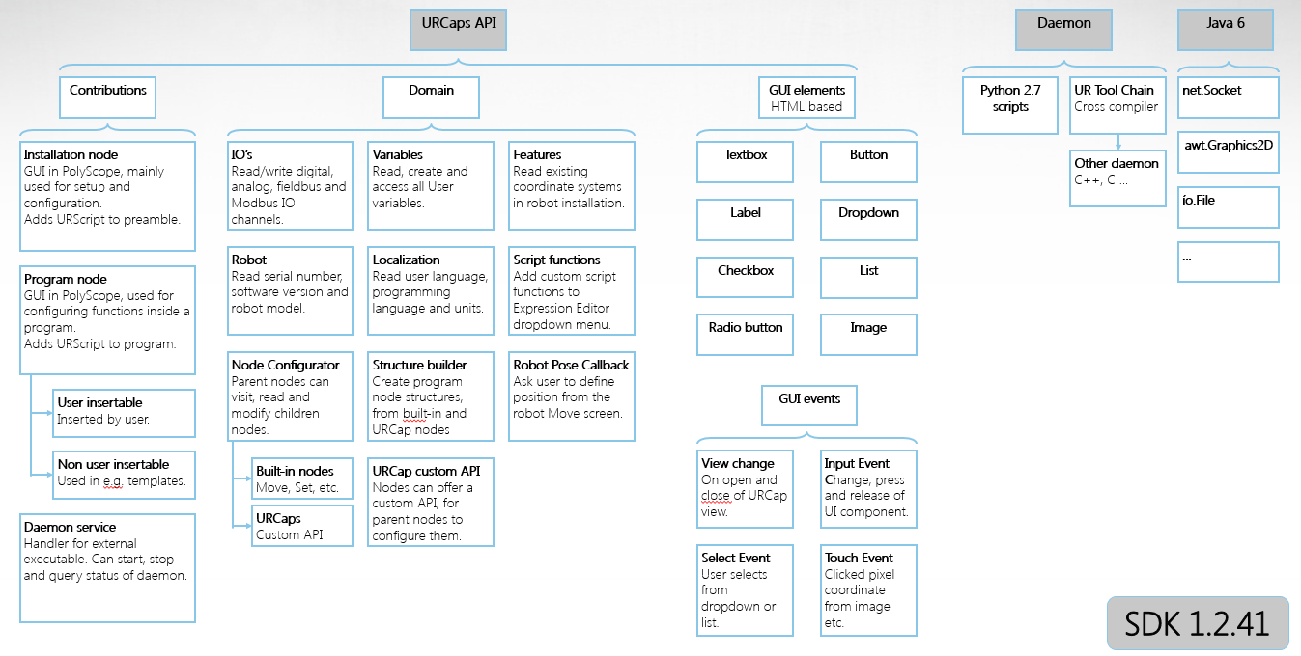
URCaps API Overview
Notes:
URCap add Java generics,

Slide 12
URCaps integration in Polyscope
PolyScope
Activator
ProgramNodeService
ProgramNodeContribution
URCaps
MyURCap
InstallationNodeService
InstallationNodeContribution
…
DaemonService
DaemonContribution
Boot
Registration of services
Functional code
Initialization
User initiated actions

Slide 13
URCaps integration in Polyscope
Registration of services
Functional code
Activator
ProgramNodeService
ProgramNodeContribution
// Called when PolyScope boots
start() {
registerService(ProgramNodeService);
}
// Called when shutdown
stop() {
}
getTitle()
- The title shown in Structure tab
isChildrenAllowed()
- If the node may have children nodes
getHTML()
- Loading the UI setup
createNode()
- Invoke a new instance of this node, returning the ProgramNodeContrib.
getId() isDeprecated()
openView() closeView() - Called when user enters this node
getTitle() - The title shown in the Program Tree
isDefined() - If the user has configured the node
generateScript() - Called to compose URScript
Functional code for the URCap…

Slide 14
What files Are needed?
per URCap
per Node type
Activator.java
ProgramNodeService.java
pom.xml
ProgramNodeContribution.java
ProgramNode.html

Slide 15
URCaps API – the basics
The URCap
PolyScope
Activator
start(){
registerService(InstallationService);
}
stop(){
}
HTML (& CSS)
<p> Please input a number in this textfield: </p>
<input id=”myInput” type=”number”>
MyURCap .urcap
InstallationNodeContribution
openView(), closeView() – load settings in GUI
isDefined() – is all data setup by user?
generateScript() – contribute script to preamble
@Input(id=”myInput”) – linked to the input in HTML
InputTextField MyINP;
private void saveUserInput(int n){
model.set(KEY, n); - store value for this Installation
}
private int getUserInput(){
return model.get(KEY, default);
}
InstallationNodeService
getTitle() – name in Installation tree
getHTML() – load GUI setup
createInstallationNode() –
InstallationNodeContribution
Required method, @Override
Optional method

Slide 16
Script generation - example
@Override
public void generateScript(ScriptWriter writer){
writer.appendLine(”# This is a comment from a URCap”);
writer.assign(”myVariable”, ”42”);
writer.globalVariable(”anotherVariable”, ”True”);
writer.ifCondition(”myVariable > 10”);
writer.appendLine(”popup(\”myVariable is > 10\”)”);
writer.end();
writer.sleep(2);
writer.appendLine(”movej(p[0.1,0.2,0,0,3.1415,0])”);
}
Script code output:
# This is a comment from a URCap
myVariable = 42
global anotherVariable = True
if( myVariable > 10 ):
popup(”myVariable is > 10”)
end
sleep(2)
movej(p[0.1,0.2,0,0,3.1415,0])

Slide 17

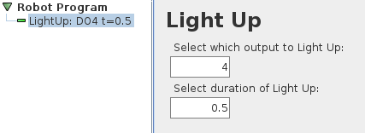
URCaps – example: LightUp
Existing script function
def lightUp(n, t):
set_digital_out(n, True)
sleep(t)
set_digital_out(n, False)
end

Slide 18
Steps
Create new URCap Project using ”newURCap.sh” tool
Import URCap Project in Eclipse IDE
Create files (…NodeService, …NodeContribution, HTML)
Develop the ProgramNodeService
Develop the HTML user interface
Develop the ProgramNodeContribution
Register the ProgramNodeService in Activator
Configure POM.xml file for deployment
Build and deploy URCap to PolyScope

Slide 19
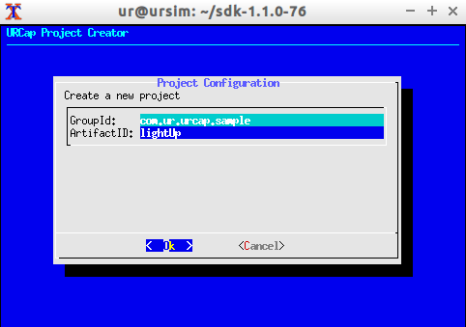
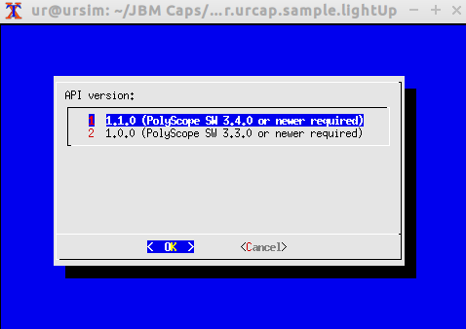
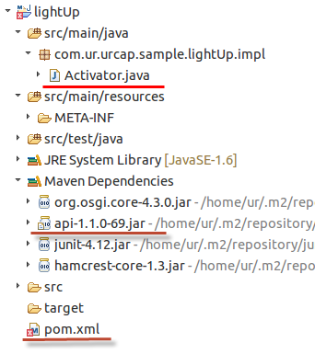
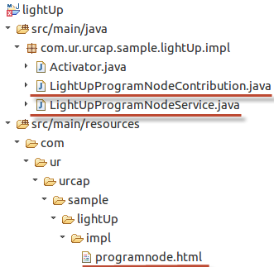
Creating the URCap project
1
Run newURCap.sh
com.ur.urcap.sample.lightUp
Import into IDE
as Maven project
3
2
Notes:
1. Under sdk1.1.xxx folder, write this ./newURCap.sh
2. Package Explorer, Right click and Import Maven Project, existing project
3. Create manually the folders under Resources, com.ur.urcap.sample.lightUp.impl

Slide 20
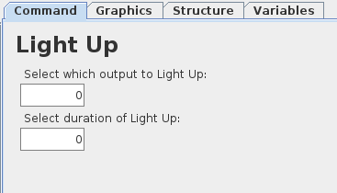
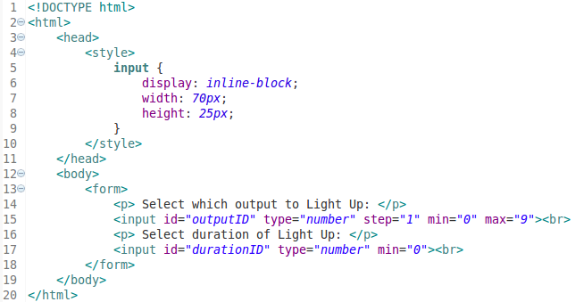
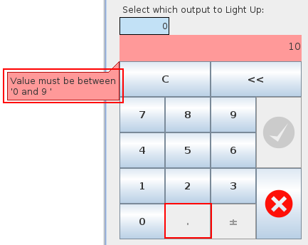
Creating the GUI – programnode.html

Slide 21
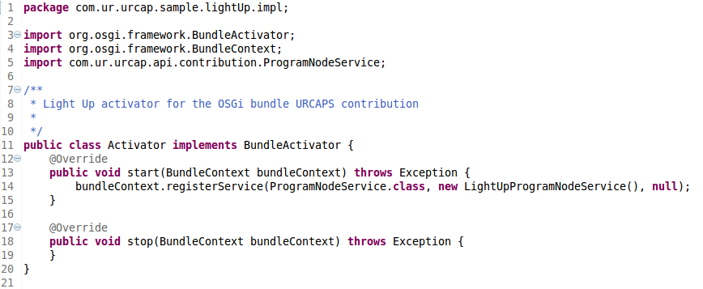
Activator
Notes:
1. Register an object of your class to the service in TAP window >bundleContext.registerService(ProgramNodeService.class, new yourClass(), null);>

Slide 22
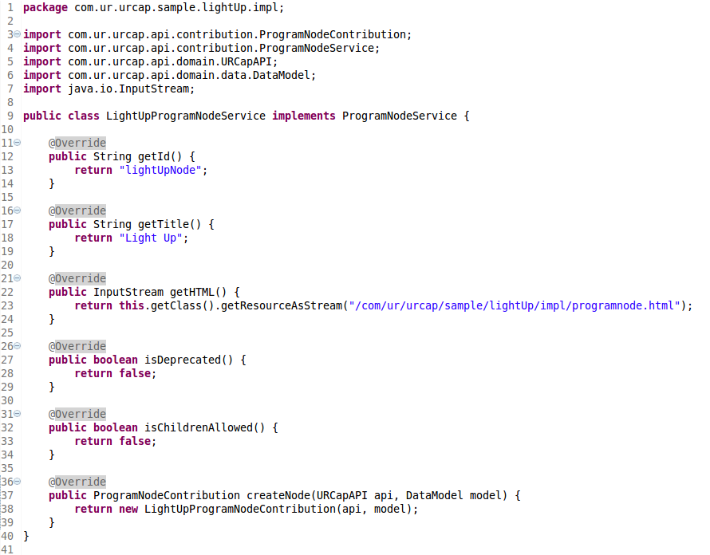
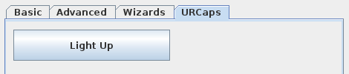
LightUpProgramNodeService

Slide 23
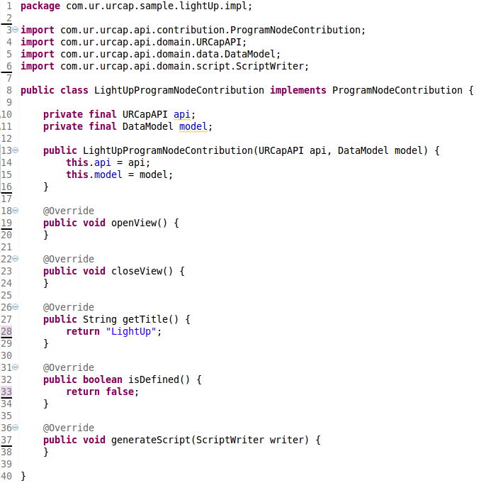
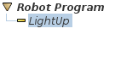
LightUpProgramNodeContribution – ”blank”
Notes:
1. GenerateScript(ScriptWriter writer), make the script line of code.
2. getTitle() makes the line $

Slide 24
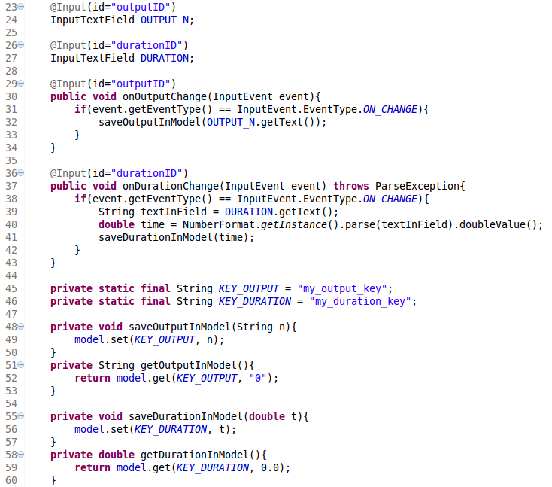
Tying the inputs to the Contribution
Register inputs
import com.ur.urcap.api.ui.component.InputTextField
import com.ur.urcap.api.ui.annotation.Input
import com.ur.urcap.api.ui.component.InputEvent
Methods for handling input changes
Make sure to convert floats to dot notation
”1,5” ➔ 1.5
Store settings in DataModel for this node
Notes:
Implement before constructor

Slide 25
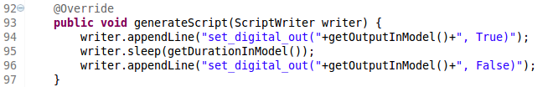
Generating the script

Slide 26
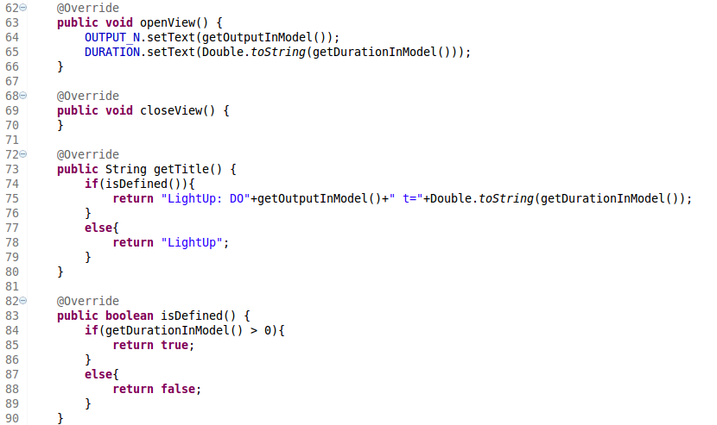
Setting up the visuals

Slide 27
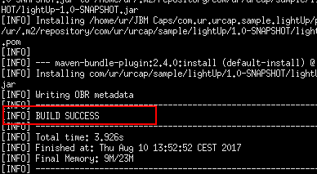
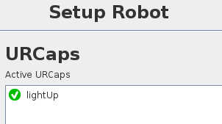
Building and deploying the URCap manually
Building URCap
Build the URCap with Maven
ur@ursim:~/com.ur.urcap.sample.lightUp$ mvn install
Copy URCap from URCap-folder to /programs/
ur@ursim:~/com.ur.urcap.sample.lightUp$ ls
pom.xml src target
ur@ursim:~/com.ur.urcap.sample.lightUp/target$ ls
lightUp-1.0-SNAPSHOT.jar lightUp-1.0-SNAPSHOT.urcap
classes generated-sources …
Deployment methods:
Manual deployment
Deploy to robot over Ethernet
Deploy in URSim (e.g. Starter Package)
Deploy to other URSim VM
(Explained in tutorial and forum)
Notes:
Under folder /ursim-current/ type ./start-ursim.sh UR10 or UR3, UR5 for debugging… System.out.println(….text…..)

Slide 28
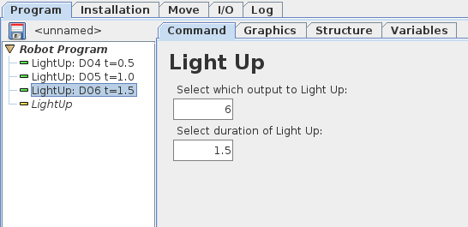
URCap is now deployed and working
Script code output to program:
# begin: URCap Program Node
# Source: lightUp, 1.0.0.SNAPSHOT, URCaps R us Inc.
# Type: Light Up
$ 4 "LightUp: DO6 t=1.5"
set_digital_out(6, True)
sleep(1.5)
set_digital_out(6, False)
# end: URCap Program Node

Slide 29
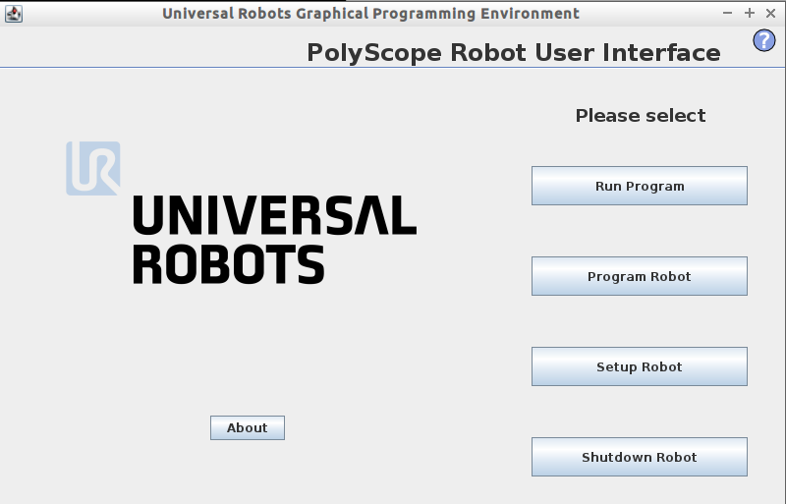
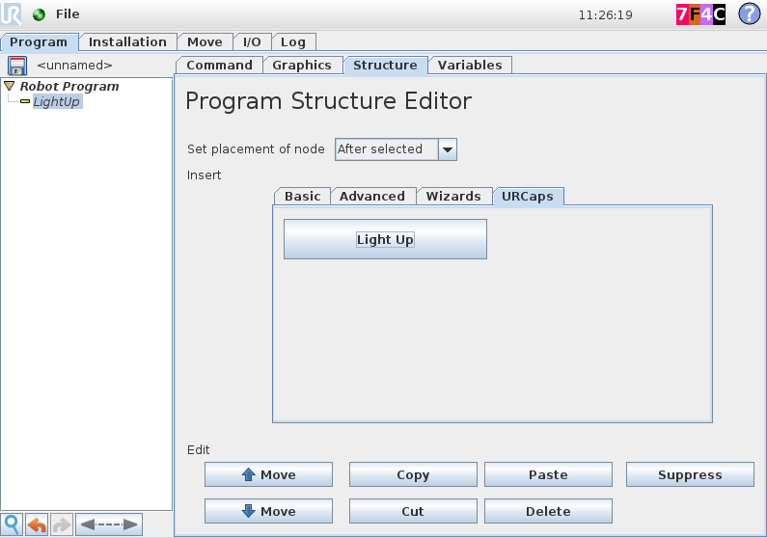
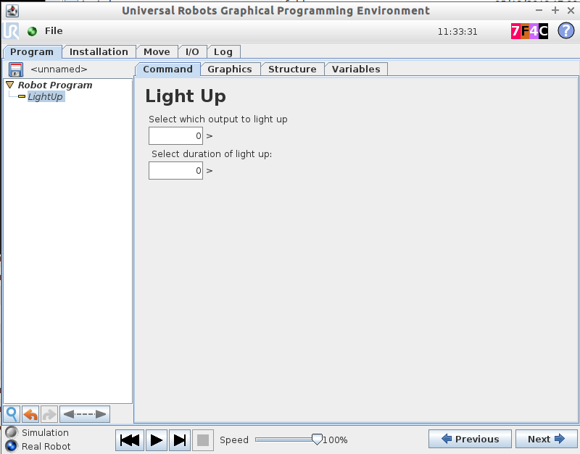
Running sequence of URCap
Node Service / getHTML
Node Service / getID
Node Service /getTitle
Node Service / create node
Node Contribution / class constructor
Node Contribution / is definied, NO
Node Contribution / getTitle
Node Contribution / OpenView
Node Contribution / outputID
Node Contribution / durationID
Node Contribution / is definied, YES
Play
Node Contribution / generate Script
1
2
3

Slide 30
Todays task
Develop a URCap which functionality you define yourself. E.g. a new sample for the Development Forum, or a tool to help your daily work.
Todays objective
Gain hands-on experience with development of URCaps, to better understand and support our Developers.

